Slide 1
INDOCTRINATION
FOR A BETTER FUTURE
JUST BE YOURSELF ,THERE IS NO ONE BETER.

Slide 2
CONTENTS OF THIS TEMPLATE
Here’s what you’ll find in this presentation:
A brief description about indoctrination with its objectives.
Methods on running the online lessons more effectively.
Information about the activities that we will do for the betterment of the students.
Details about the resources that we will be providing to the students.

Slide 3
OUR TEAM
We are a group of students working together in an idea for the production of ideal result.

Slide 4
TABLE OF CONTENTS
1
2
3
4
INTRODUCTION
ONLINE LESSONS
ACTIVITIES
RESOURCES
Indoctrination is a place for everyone to enlighten themselves.
Live tutors as well as visually fascinating video for study will be available for the students.
Regular asignments will be given to the students.
Books, notes ,etc will be available with download facility.

Slide 5
1
INTRODUCTION

Slide 6
INDOCTRINATION
Here , all the students, normal as well as disabled students will be able to get knowledge that they deserve.

Slide 7
EDUCATION FOR ALL
Normal
Disabled
Students will be able to choose the desired subject that they want to study.
Even disable students will be able to educate themself from qualified tutors.

Slide 8
Our Process
Search
Select
Learn
Choose an online lesson or meeting according to your preference
Find a tutor in your
preferred category.
Get knowledge together with the tutor.

Slide 9
2
ONLINE LESSONS

Slide 10

Know The Real You
Working forward for the betterment of students.

Slide 11
SUBJECTS FOR ONLINE LESSONS
PROGRAMMING
MATH
SCIENCE
VISUAL ART
MANY MORE

Slide 12

Proffessional Learning
Students can also get professional education in their desired field.
Our focus will be more on professional learning than that of theoretical learning.

Slide 13

LIVE STREAMING
Tutors will be available 24hrs for all the students .

Slide 14
ONLINE
COURSE
LEARNING WITH MOBILE
NEVER
STOP
LEARNING!
Students will be able to study by using mobile.
LEARN

Slide 15
We bring learning to the people instead of people to learning.

Slide 16
3
ACTIVITIES

Slide 17
ASSIGNMENTS
Weekly assignment will be given to the students, for both normal and disabled.

Slide 18
Q&A Sessions
Q&A Sessions will be kept for improving students self-confident

Slide 19
EXAMS
Periodic online examination will be help to keep records of the students improvement.

Slide 20
TOWARDS BRILLIENCE
Sign-Language
Tutor
Animate Videos
Animated Videos
Live Tutors
Tests
Tests
Audio Tutoring
Books & Notes
Assignment
Q&A

Slide 21
—NELSON MANDELA
NEVER STOP LEARNING.
“IT ALWAYS
SEEMS
IMPOSSIBLE
UNTIL
IT’S DONE.”

Slide 22


A PICTURE IS WORTH A THOUSAND WORDS
EDUCATION
FOR ALL

Slide 23
4
RESOURCES

Slide 24

BOOKS
Every subject related books will be available to all the students with the facility of downloading.

Slide 25
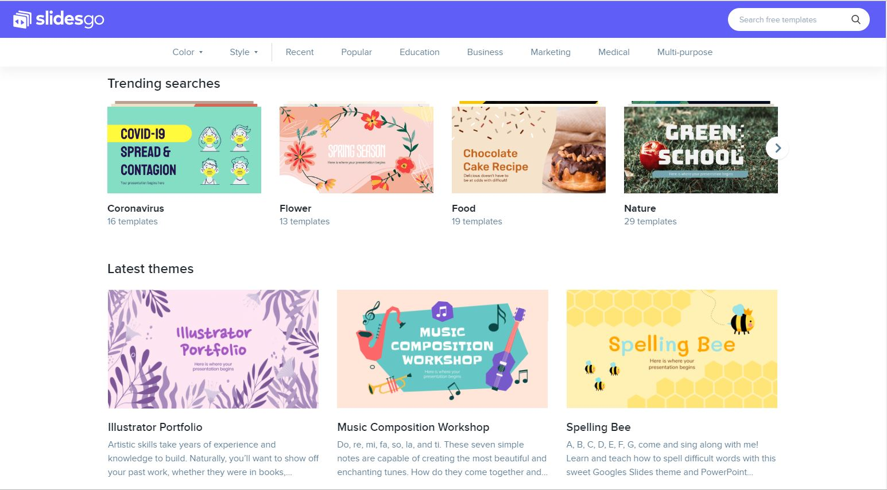
AUDIO & VISUAL RESOURCES
Audio and video arts will be available for the students , especially disabled.

Slide 26
SUBJECT WISE NOTES
Every subject notes will be available.

Slide 27
THANK YOU

